Slide 1
Off-Line Tuning
Start
On-Line Tuning
Start
Detection of disturbance
Detection of disturbance
Determining
Frequency
Amplitude
Bandwidth
Of disturbance
Halt/Pause the system
or
Deactivate the load
Start pre-defined routines
Activate the filtering
Calculate/Estimate/Predict
Electrical & Mechanical parameters
Calculate/Estimate/Predict
Electrical & Mechanical parameters
Set controller/driver
Update controller/driver
Reactivate the system
Trace next disturbance

Slide 2
Transmission
Load
PMSM Servo Motor
pulley-belt
lead-screw
rack-pinion
belt-wheel
conveyor
gear-wheel
direct drive
linear
rotational
contour
custom
motion
Coupler
Torsion
Transmission
Load
pulley-belt
lead-screw
rack-pinion
belt-wheel
gear-wheel
direct drive
linear
rotational
contour
custom
motion
PMSM Servo Motor
Coupler
Flexion

Slide 3
Gear gap (backlash)
Tooth corrosion

Slide 4
Servo motor
Friction
Sliding
Sag

Slide 5
Servo Motor
Axis shift

Slide 6
Real Parameters
Ref
Position
Speed
Torque
Real System
Driver+Servo+Load
Observed
Parameters
+
-
Model of Real System
K
Minimizing the error

Slide 7
Real Parameters
Ref
Position
Speed
Torque
Real System
Driver+Servo+Load
+
Estimated Parameters
-
Model of
Real System
Estimator
Regression vector
Background data

Slide 8
Real Parameters
Real Parameters
Ref
Position
Speed
Torque
Real System
Driver+Servo+Load
Ref
Position
Speed
Torque
Real System
Driver+Servo+Load
Predicted
Parameters
+
Estimated
Parameters
+
-
-
Model of
Real System
Model of
Real System
Predictor
Estimator
Prediction
Background
data
Regression
Vector
Background
data
Probabilities
Update

Slide 9
Ref
Position
Speed
Torque
Real System
Driver+Servo+Load
+
-
Adjustable
Model
Calculated
Parameters
Adaptive
mechanism

Slide 10

measured speed
Encoder
Transmission
+
Load
Servo Motor
Speed
Reference
-
Speed
Controller
Adaptive
Notch Filter
Torque
Controller
+
TF1
TF2
TFn
Disturbance
Detector
, BW, Q factor

Slide 11
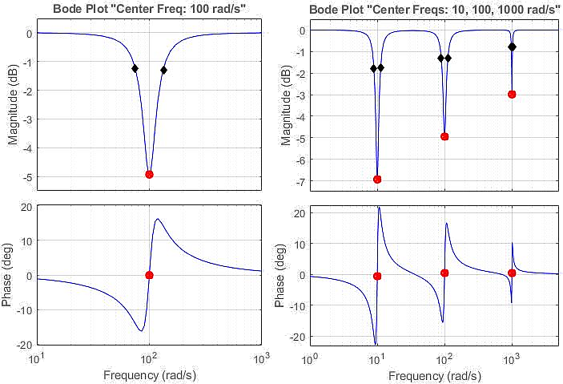
Depth
BW
Center Freq

Slide 12
TI TMS320F28335
32-bit MCU with 150 MIPS, FPU, 512 KB Flash, EMIF, 12b ADC
5kHz switching Freq SVPWM
Direct drive Adaptive PI controller + Estimator
(Online Parameter Estimation Technique for Adaptive Control Applications of Interior PM Synchronous Motor Drives)
NXP MPC8240 processor
64-bit floating-point, 250 MHz, 2 x 16KB cache, on-chip, 32 MB SDRAM, 8MB Flash, 16b ADC/DAC
10kHz Switching Freq
Belt drive two mass +Speed controller +Torque Control FOC (sampling 10kHz) + Pram identification
(Identification of Two-Mass Mechanical Systems Using Torque Excitation: Design and Experimental Evaluation)
(A friction model-based frequency response analysis for frictional servo systems) (friction response analysis FFT)
TMS320F28075
32-bit MCU with 120 MHz, FPU, TMU, 512 KB Flash, CLA, SDFM
10kHz SVPWM
Direct drive with torque sensor + Fuzzy network + Inertia identification
(Online Auto-Tuning Technique for IPMSM Servo Drive by Intelligent Identification of Moment of Inertia)

Slide 13
NXP MPC8240 processor
64-bit MCU with 250 MHz, FPU,
2 x 16KB cache, on-chip,
32 MB SDRAM, 8MB Flash,
16b ADC/DAC
(Identification of Two-Mass
Mechanical Systems Using Torque Excitation:
Design and Experimental Evaluation)
Process 1:
10kHz-SVPWM
Belt drive two mass
Speed controller
Torque Control FOC
Parameter identification
Process 2:
Nonlinear friction analysis
DFT
Linearization
(A friction model-based f
requency response analysis
for frictional servo systems)
(friction response analysis FFT)
XILINX Virtex-5 FPGA
64-bit MCU with 550 MHz, FIFO,
36-Kbit block RAM,
64-bit distributed RAM option,
(An FPGA-based parallel
architecture for
on-line parameter estimation
using the RLS identification
algorithm)
Process :
Position control (FOC)
RLS algorithm
Parameter identification
TI TMS320F28075
32-bit MCU with 120 MHz,
FPU, TMU, 512 KB Flash,
CLA, SDFM
Process:
10kHz-SVPWM
Direct drive
Fuzzy network
Inertia identification
(Online Auto-Tuning
Technique for IPMSM Servo Drive
by Intelligent Identification of
Moment of Inertia)
TI TMS320F28335
32-bit MCU with 150 MHz,
FPU, 512 KB Flash, EMIF,
12b ADC
Process:
5kHz-SVPWM
Direct drive
Adaptive PI controller
Estimator
(Online Parameter Estimation
Technique for Adaptive Control
Applications of Interior PM
Synchronous Motor Drives)
CPU clock
120MHz
150MHz
250MHz
340MHz

Slide 14
NXP MPC8240
64-bit MCU, 250 MHz
FPU, 2 x 16KB
cache on-chip
32 MB SDRAM,
8MB Flash
Ex. Process 1:
10kHz-SVPWM
Belt drive two mass
Speed&Torque Control FOC
Parameter identify
Ex. Process 2:
Nonlinear friction analysis
DFT, Linearization
XILINX Virtex-5 FPGA
64-bit MCU,
550 MHz
FIFO, 36-Kbit
block RAM
64-bit distributed RAM
Ex. Process :
Position control (FOC)
RLS algorithm - Online
Parameter identification
TI TMS320F28075
32-bit MCU,
120 MHz
FPU, TMU, 512 KB
Flash, CLA, SDFM
Ex. Process:
10kHz-SVPWM
Direct drive
Fuzzy network
Inertia identification
TI TMS320F28335
32-bit MCU,
150 MHz
FPU, 512 KB Flash,
EMIF, 12b ADC
Ex. Process:
5kHz-SVPWM
Direct drive
Adaptive PI control
Estimator
120MHz
150MHz
250MHz
340MHz
CPU

Slide 15
d-axis
d-axis
q-axis
q-axis
PM
g
g
h
SPMSM
h
IPMSM

Slide 16






Load
Servo

Slide 17




-
+
-
+
-
+

Slide 18





Adjustable
Model
Position
Controller
Analyzer
Freq. Domain
Time Domain
Adaptive
Numerical
Observer
Estimator
Predictor
AI Based
Filtering
Speed
Controller
+
+
error
or
data
+
+
-
-
-
Torque
Controller
-
Current
Voltage
Controller
Driver
PMSM
Disturbance
Load

Slide 19
feedback
Servo
Drive Train
Ref
Controller
Driver
option 3
Disturbance
Filter
FFT
+
DSP
option 2
Notch
Bi-quad
LPF,BPF,HPF
Disturbance
detection
characterization
option 1

Slide 20
OFF-LINE TUNING
Start
ON-LINE TUNING
Start
Stop / No-loaded / Dummy
MOTION
Keep Functional
MOTION
Previous Info
Commission
or
Self-Commission
Dynamic Measurements/Decisions
No Info
Parameter Estimation
Tuning System
Parameter Estimation
Tuning System
Activate Functional Motion
Update Functional Motion

Slide 21
Adjustable
Model
Torque
loop
Position loop
Speed loop
Opt 4
Load
Position
Control
Speed
Control
Torque
Control
FOC
+
Driver
M
Opt 2
Opt 3
-
Opt 1
Freq. Domain, Time Domain, Adaptive, Numerical
Observer, Estimator, Predictor, AI Based, Filtering
+
Disturbance
Analyzer

